Slide 1
AWS X-Ray for Distributed Tracing
UI Developer Community
Michael Alberhasky
November 19, 2019

Slide 2
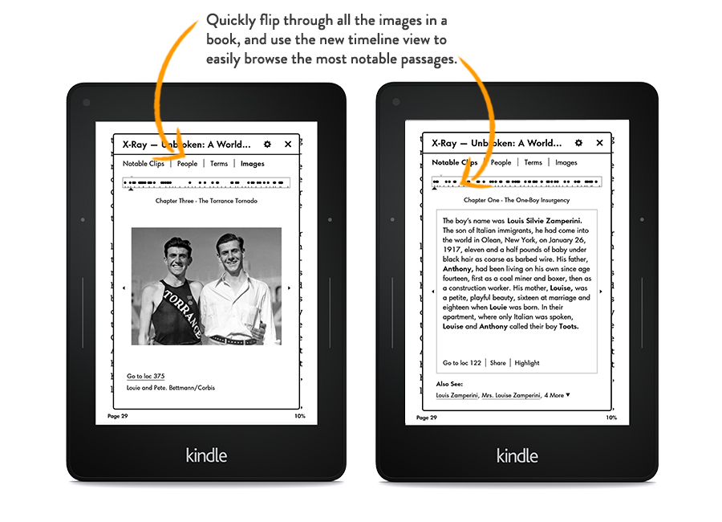
Not this Amazon X-Ray

Slide 3
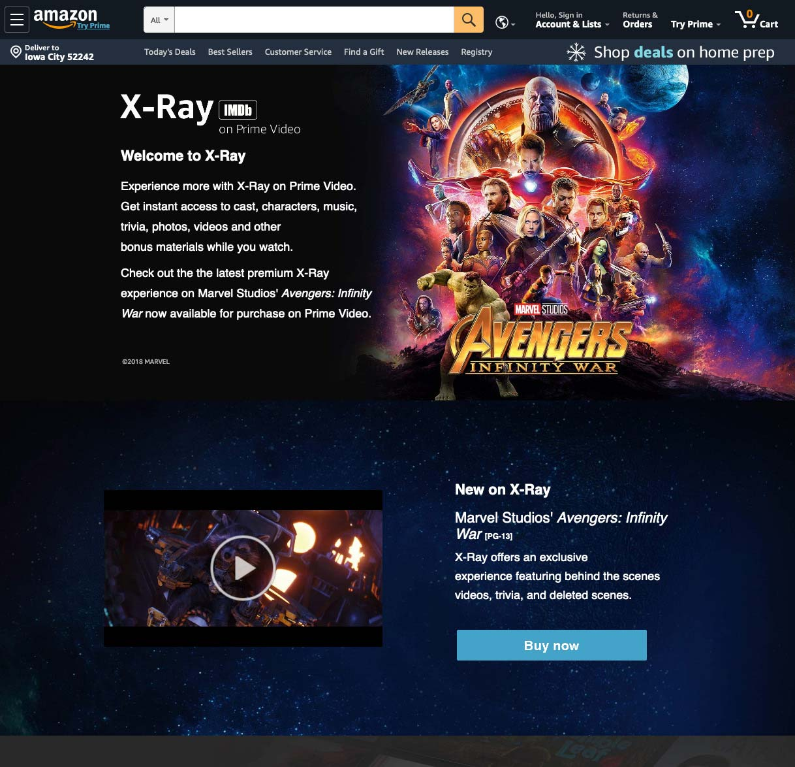
And Not This Amazon X-Ray Either

Slide 4

Not these either

Slide 5
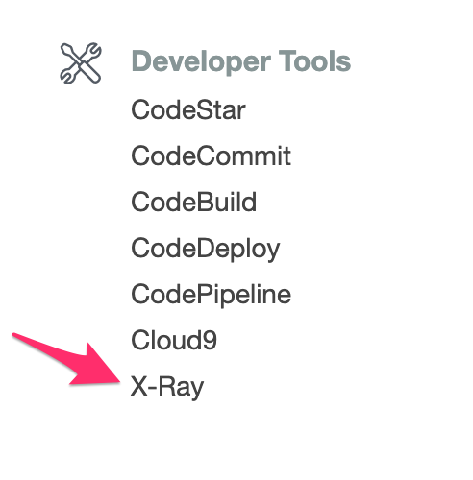

This X-Ray

Slide 6
Observability into Managed Services
Can’t just connect your favorite tool to JVM, etc.
Options:
  Log the snot of your app
  Employ a third party service like DataDog or NewRelic
  Use X-Ray

Slide 7
What is AWS X-Ray?
Collects data about requests and responses
Provides profiling
Insight into performance of downstream AWS resources
Exception collection

Slide 8
Concepts
Traces: Lambda invocations or API Gateway requests.
Segments: Major work units
Subsegments: More granular work units under a segment
Annotations: Key/Value pairs you can place with segments or subsegments. You can filter on these.
Metadata: Key/Value pair data you want to store alongside the trace.
Sampling: How much of your executions you want to profile. The default is a limit of 1 request/sec with a max of 5% of all requests.

Slide 9
What can you trace?
Lambda and API Gateway: Easy to enable.
AWS Services: X-Ray SDK automatically instruments all AWS SDKs when Instrumentor module is added to classpath.
SQL: If you are using PostgreSQL or MySQL you can also add in a JDBC interceptor to trace SQL calls.
HTTP calls: X-Ray SDK supports a proxy to Apache HttpComponents.
Incoming requests: Tomcat and Spring filters.
Custom segments: Using X-Ray SDK and X-Ray daemon if not a natively supported service.

Slide 10
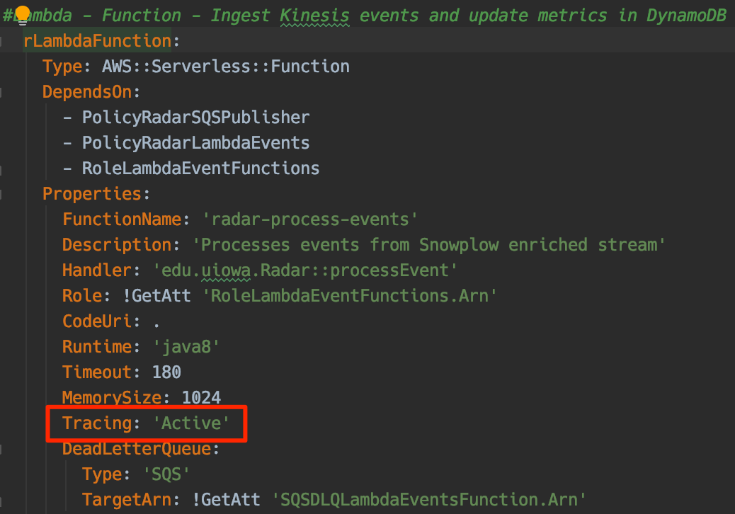
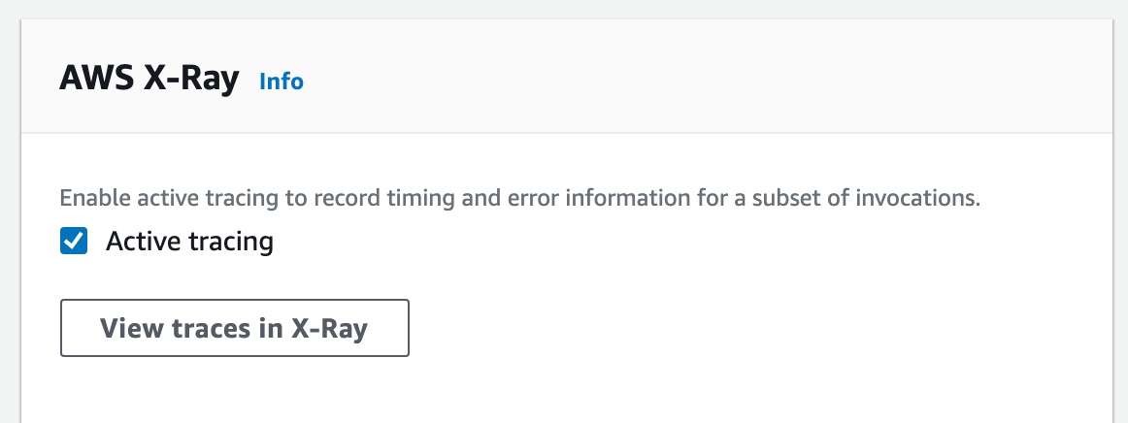
Easy to enable
Via CloudFormation
Via Lambda Console

Slide 11
Grant Permissions
Policy needs rights to send data to X-Ray.
Policy needs granted to Role which is granted to executing resource.
One of those services you just need to grant ”*” to for it work.
{
“Action”: [
“xray:PutTraceSegments”,
“xray:PutTelemetryRecords”
],
“Resource”: “*”,
“Effect”: ”Allow”
}

Slide 12








Radar Use Case
AWS Cloud
UIowa
DynamoDB
Tables
Kinesis Stream
Lambda Function
Dispatch
COMMPROD
RabbitMQ Queue

Slide 13
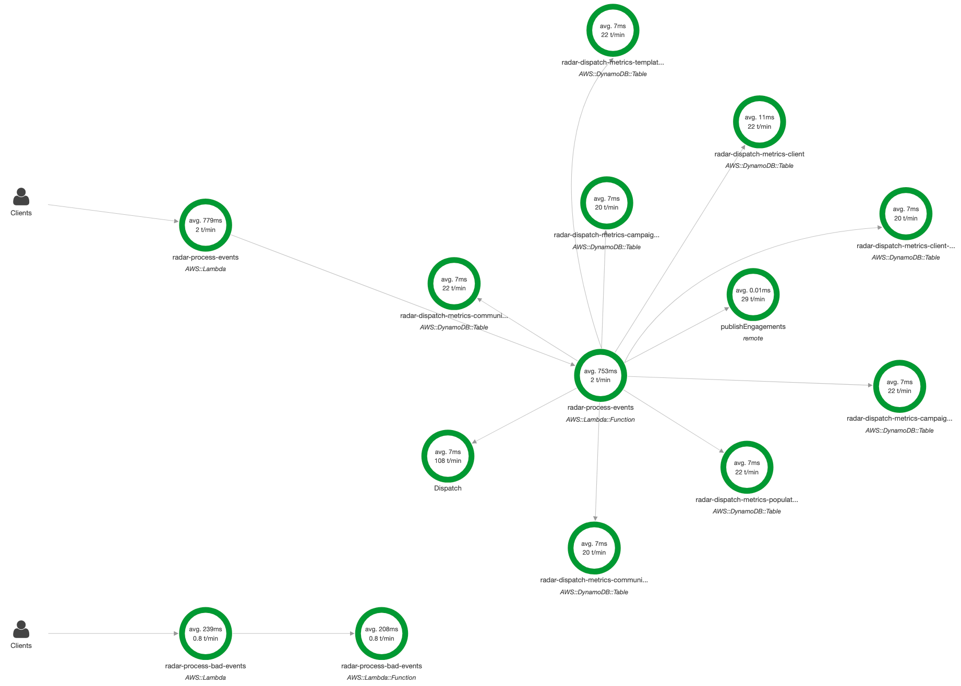
Service Map

Slide 14
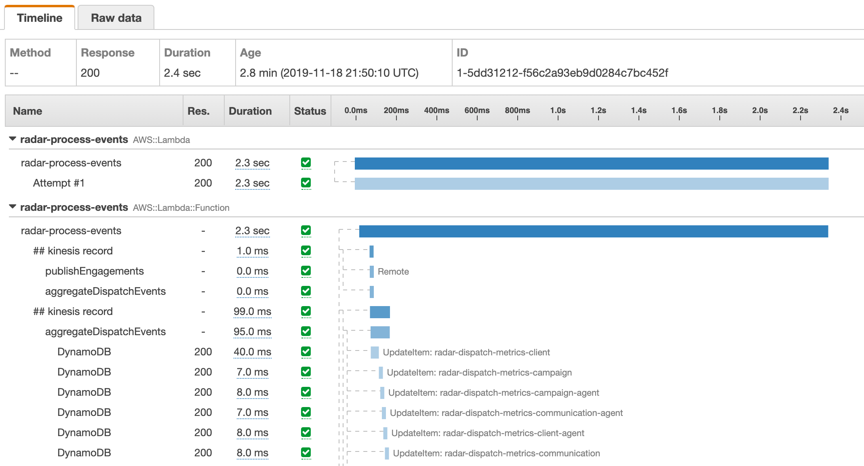
Traces

Slide 15
More Info & Questions
X-Ray Developer Documentation: https://docs.aws.amazon.com/xray/latest/devguide/aws-xray.html
Michael Alberhasky
michael-alberhasky@uiowa.edu

